Slide 1
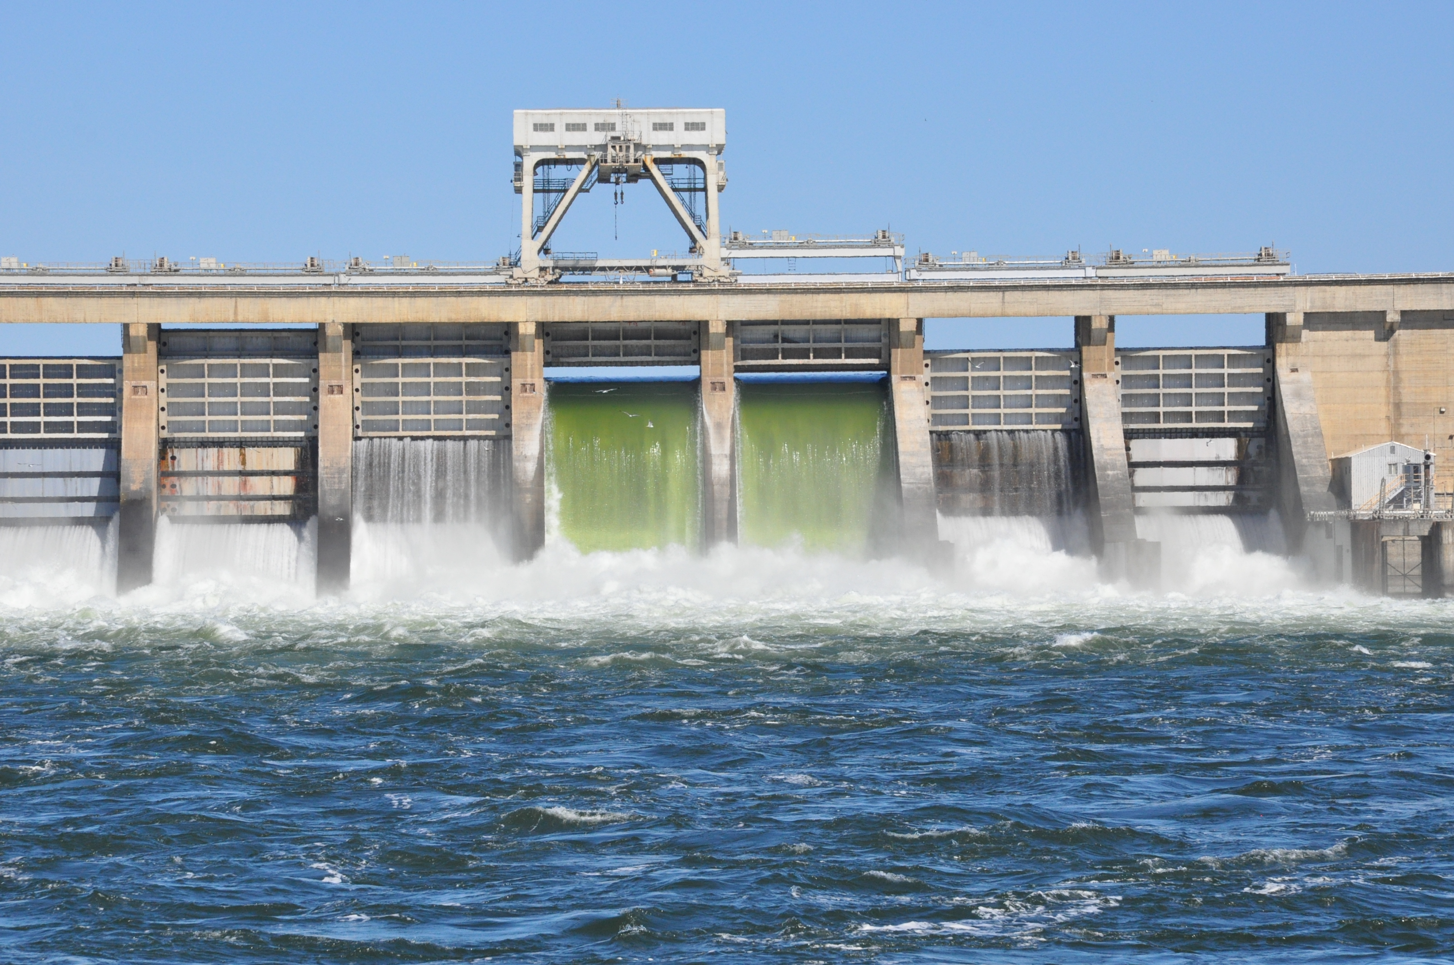
Stock photo of McNary TSW and Deep spill

Slide 2
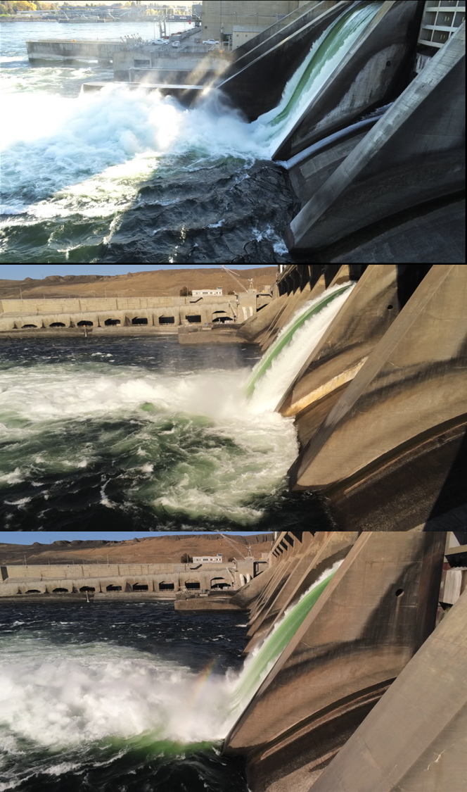
10/19/23
TSW Spill
10 kcfs
Split-leaf
Downstream
Slot
9 stops
10 kcfs
Split-leaf
Upstream
Slot
9 stops
10 kcfs

Slide 3
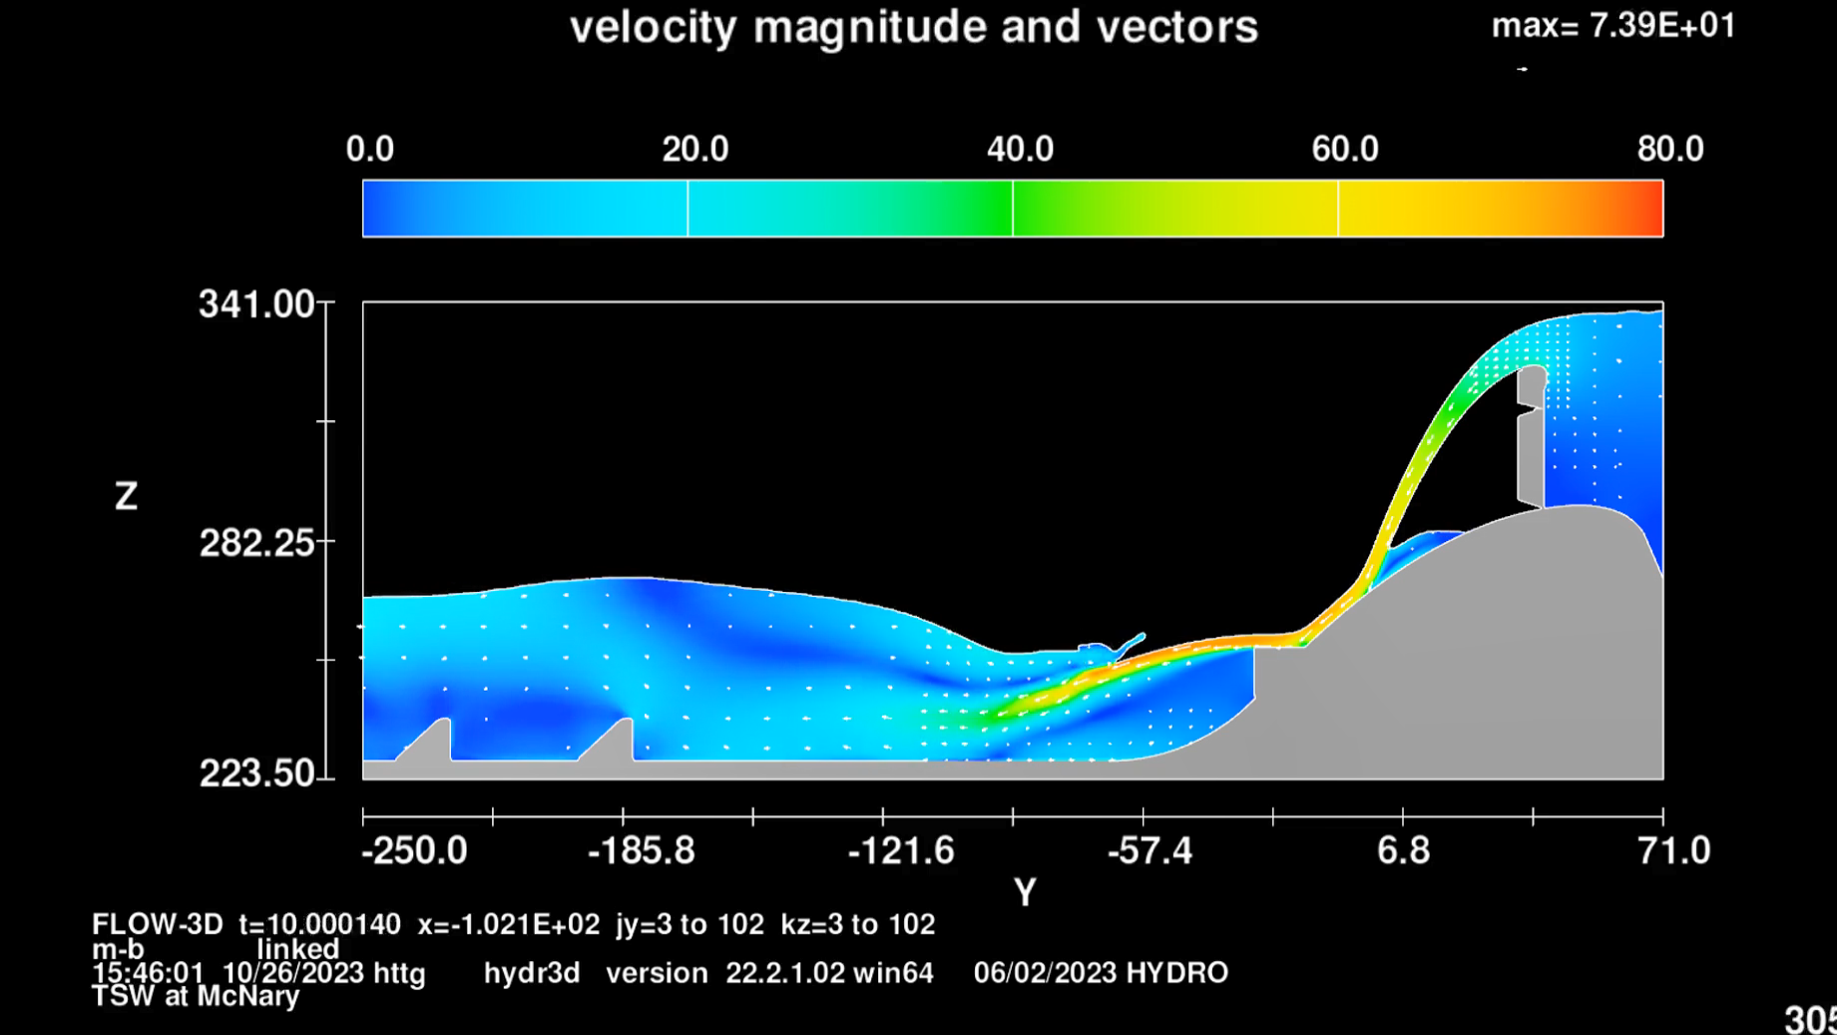
TSW
10 kcfs

Slide 4
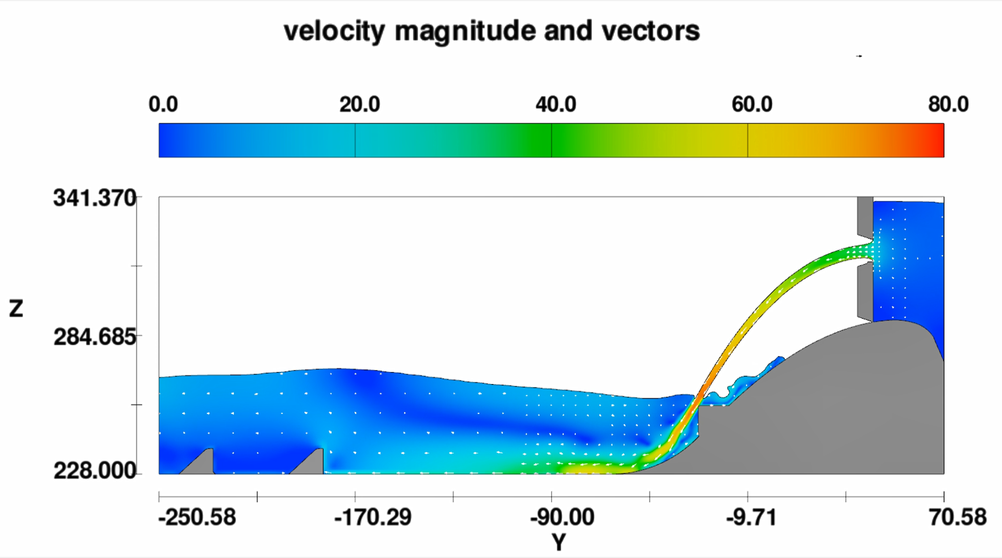
Downstream split leaf
9 ft opening
10 kcfs

Slide 5
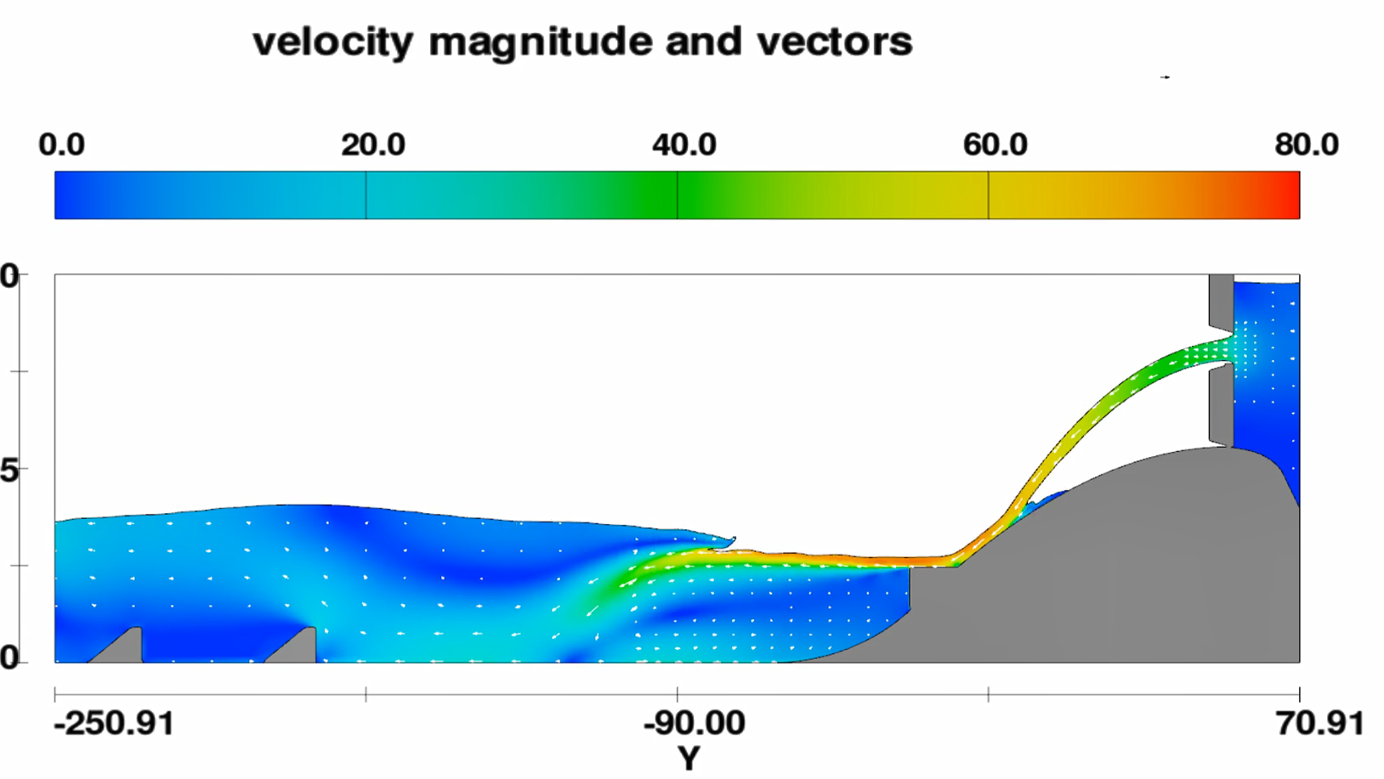
Upstream split leaf
9 ft opening
10 kcfs

Slide 6
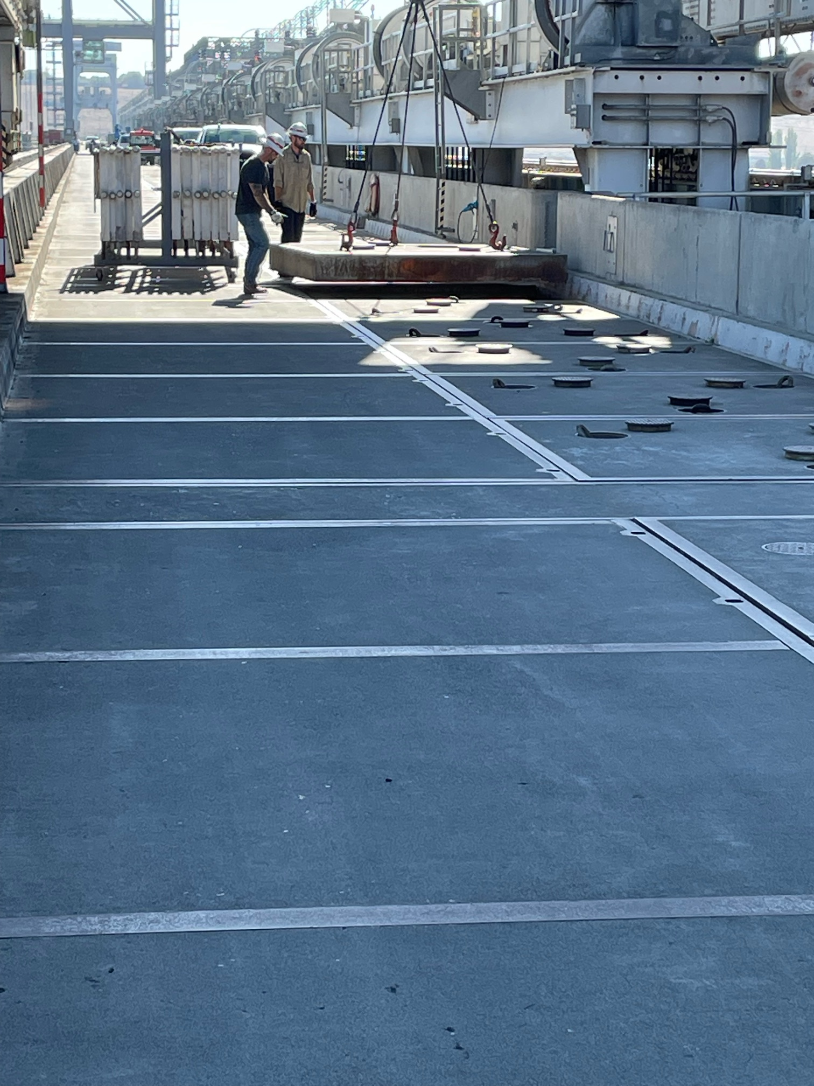
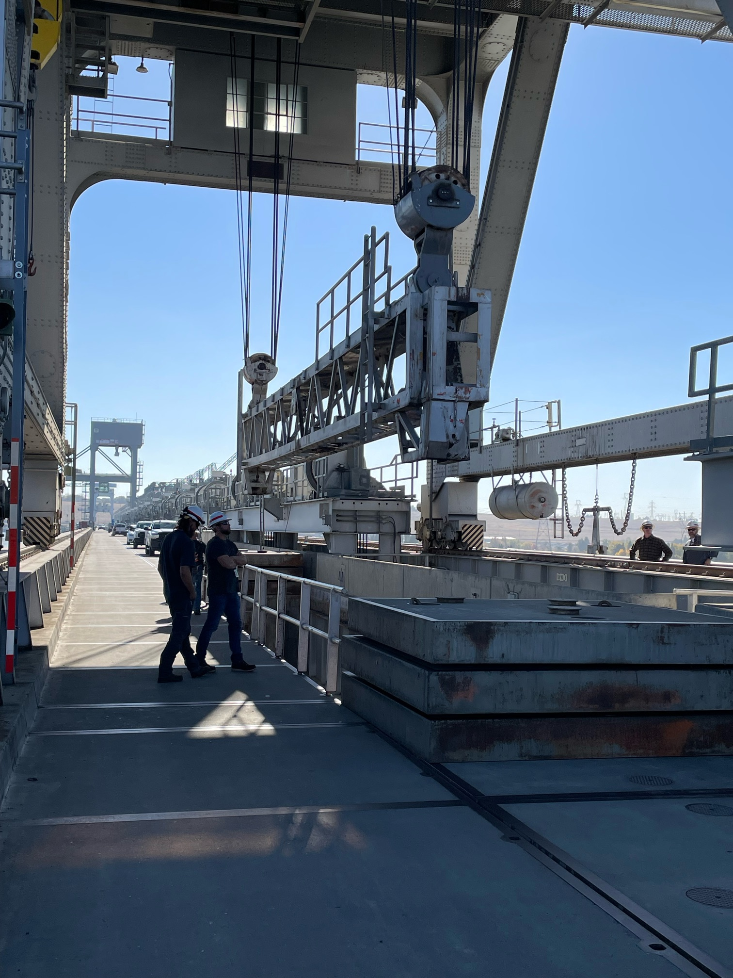
Spillway deck access to upstream slot;
Remove six deck plates
Add temporary handrails

Slide 7
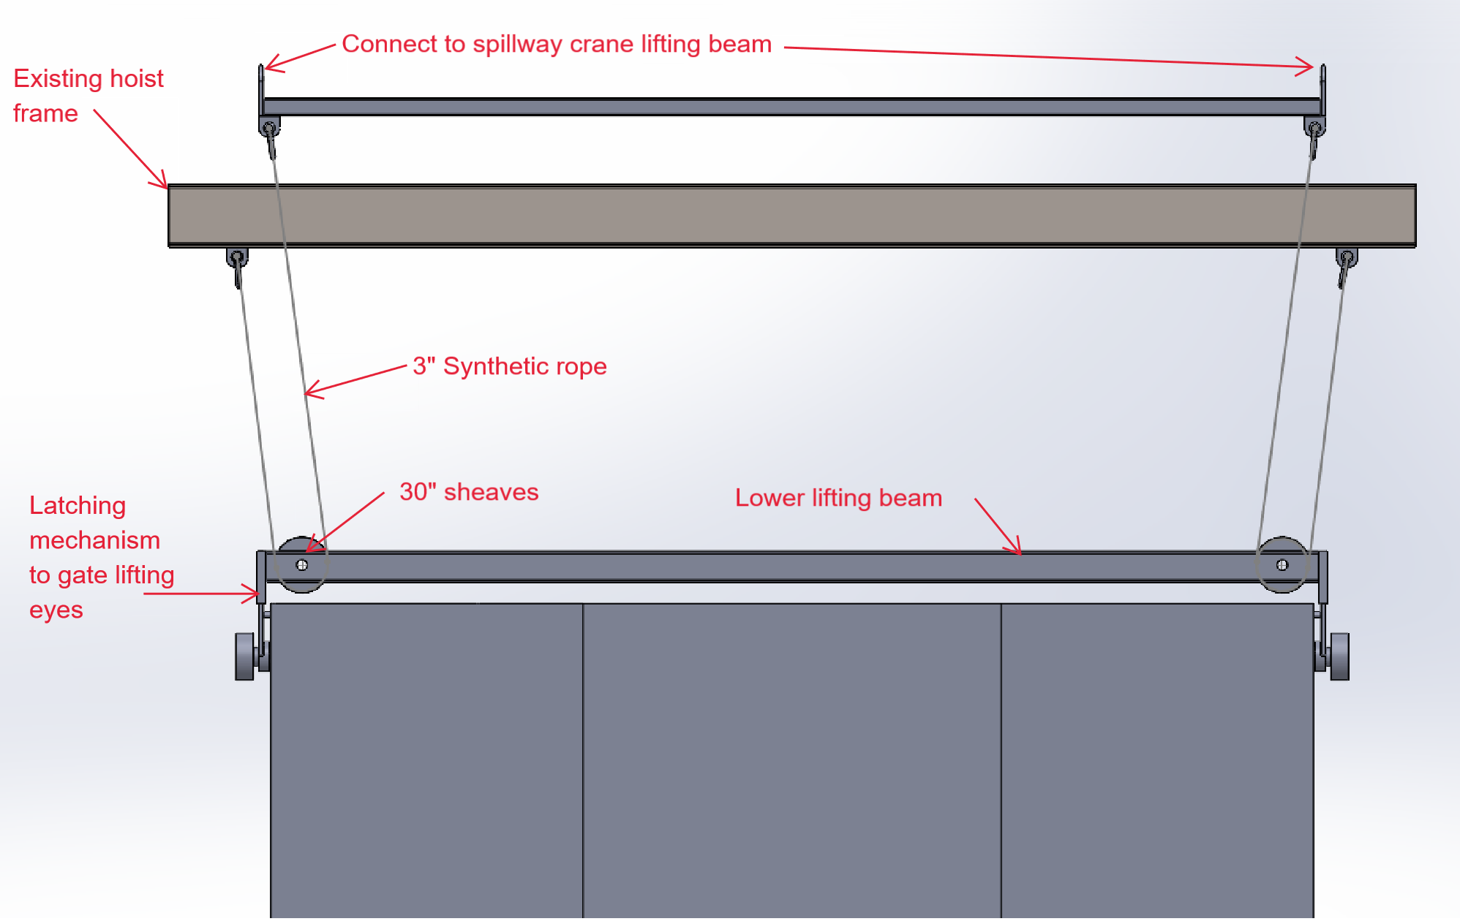
Add Pulley – Cut Weight in Half
New Beam

